Slide 1
Are Restaurant Reviews Trustworthy?
Vincent Ji
January 2020

Slide 2
Agenda
Online Review Background
Obao Midtown East Investigation
Take-aways

Slide 3
”94% of Diners Will Choose Your Restaurant Based on Online Reviews.”
– Michael Guta (Small Business Trends)
”For restaurants hoping to capture a slice of the $44 billion that tourists to NYC spend, TripAdvisor is one of the most effective ways to do it.”
– Diana Hubell (NY Eater)

Slide 4
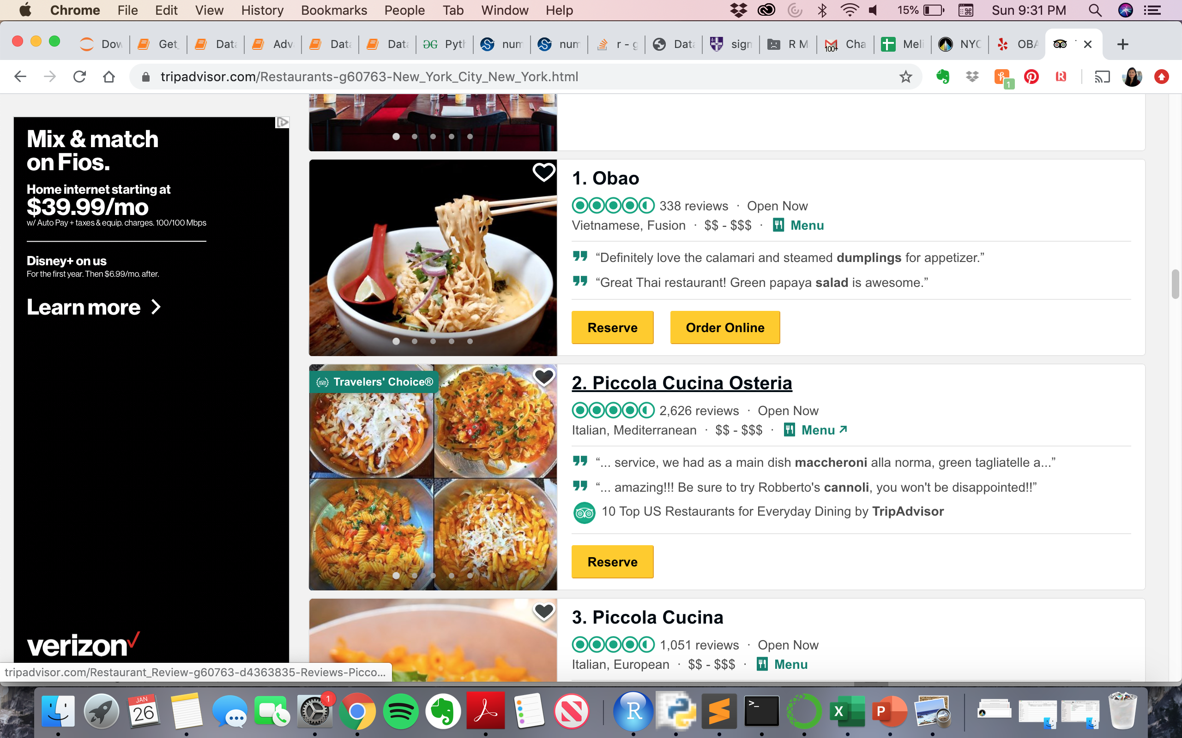
Obao ranks #1 on TripAdvisor but only has 3.5 stars on Yelp. Unusually high percentage of visitors gave the restaurant a five-star rating on TripAdvisor
Over 60% of the Tripadvisor reviewers gave five-stars

Slide 5

Obao’s rating spiked after November 2019 which coincided with a sudden increase in number of reviews in December 2019 and January 2020.
Jan’20 Z-score = 94
Dec’19 Z-score = 37

Slide 6
More than half of the reviews in Dec’19 and Jan’20 were from first time reviewers. In addition, average rating for the period is an eye-popping 4.99. This doesn’t add up...
 | Before or in Nov’19 | After Nov’19
Total # Reviews | 206 | 131
# Reviews From First Time Contributors | 2 | 79
Avg. Rating | 3.5 | 4.99
After reaching out to one of the reviewers (my former colleague), I found out that the restaurant offered a free drink for each customer who wrote a review on Tripadvisor while dining.

Slide 7
Take-aways
Customers need to look beyond aggregate ratings and ranking to find the right product for them.
Review websites such as TripAdvisor are built on credibility and user trust. They need to re-think their review platforms and prevent businesses from gaming the system.
Recommendation: adding a question before the review section asking review writers if they were asked by the business to write a review

